Slide 1
Thread
Tanjina Helaly

Slide 2
Concurrent Programming
Different parts of the same program can be executing at the same time, or behave as if they are executing at the same time.
Java uses threads to achieve concurrency.
Writing concurrent programs presents a number of issues that do not occur in writing sequential code.

Slide 3
Issues Involve in Concurrent Programming
Safety
Two different threads could write to the same memory location at the same time, leaving the memory location in an improper state.
Liveness
Threads can become deadlocked, each thread waiting forever for the other to perform a task. Threads can become livelocked, waiting forever to get their turn to execute.
Nondeterminism
Thread activities can become intertwined. Different executions of a program with the same input can produce different results. This can make program hard to debug.
Communication
Different threads in the same program execute autonomously from each other. Communication between threads is an issue.

Slide 4
What is Thread?
Thread is an independent path of execution through program code.
A multi threaded program contains two or more parts that can run concurrently and each part can handle different task at the same time making optimal use of the available resources specially when your computer has multiple CPUs.
When multiple threads execute, one thread's path through the same code usually differs from the others.

Slide 5
Why we use Threads?
To perform asynchronous or background processing
Increases the responsiveness of GUI applications while performing other tasks, such as repaginating or printing a document.
Take advantage of multiprocessor systems
Simplify program logic when there are multiple independent entities

Slide 6
What happens when a thread is invoked?
When a thread is invoked, there will be two paths of execution.
One path will execute the thread and
the other path will follow the statement after the thread invocation.
There will be a separate stack and memory space for each thread.

Slide 7
How to Create and Run Thread

Slide 8
How to Create and Run Thread
1) Define and Create a Thread object either by
Implementing the Runnable interface. And pass the object as job of the Thread object.
Extending the java.lang.Thread class.
2) For both cases we need to override “public void run()” method which should contain the code that needs to be run as Thread.
3) Start the thread of execution by calling the start() method.
Do not call the run() method directly.
Calling the run() directly executes the method in the normal sequential manner.
Do not call the start() method more than once.
After starting a thread, it can never be started again. If you does so, an IllegalThreadStateException is thrown. In such case, thread will run once but for second time, it will throw exception.

Slide 9
Implementing the Runnable Interface
The easiest way to create a thread is to create a class that implements the Runnable interface.
First, have your class implement the Runnable interface, which has one method, run().
This run() plays the same role as the run() in the Thread subclass in the first method.
Second, create an instance of the Thread class, passing an instance of your class to the constructor.
Finally, send the thread object the start() method.

Slide 10
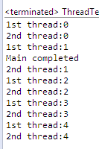
Implementing the Runnable Interface
public class ThreadTest {
public static void main(String[] args) {
Thread t1 = new Thread(new JobForThread(), "1st thread");
Thread t2 = new Thread(new JobForThread(), "2nd thread");
t1.start();
t2.start();
System.out.println("Main completed");
}
}
public class JobForThread implements Runnable {
public void run() {
for (int i = 0; i<5; i++) {
System.out.println(Thread.currentThread().getName()+":"+i);
try {
Thread.sleep(200);
} catch (InterruptedException e) {
e.printStackTrace();
}
}
}
}

Slide 11
Extending the Thread Class
In the Thread subclass, implement the run() method. The signature of run() must same as Thread class as shown in the example.
run() is the entry point or starting point (or main) of your thread.
To start a thread, create an object from your Thread class. Call the "start()“ method to the thread object.
This will create the new thread, start it as an active entity in your program, and call the run() method in the thread object.

Slide 12
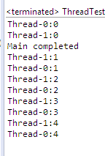
Extending the Thread Class
public class ThreadTest extends Thread{
public static void main(String[] args) {
Thread t1 = new ThreadTest();
Thread t2 = new ThreadTest();
t1.start();
t2.start();
System.out.println("Main completed");
}
public void run() {
for (int i = 0; i<5; i++) {
System.out.println(Thread.currentThread().getName()+":"+i);
try {
Thread.sleep(200);
} catch (InterruptedException e) {
e.printStackTrace();
}
}
}
}

Slide 13
Extends Thread class vs Implements Runnable Interface?
Extending the Thread class will make your class unable to extend other classes, because of the single inheritance feature in JAVA. However, this will give you a simpler code structure. If you implement Runnable, you can gain better object-oriented design and consistency and also avoid the single inheritance problems.
If you just want to achieve basic functionality of a thread you can simply implement Runnable interface and override run() method. But if you want to do something serious with thread object as it has other methods like suspend(), resume(), ..etc which are not available in Runnable interface then you may prefer to extend the Thread class.

Slide 14
Thread Scheduling & Life Cycle

Slide 15
Thread scheduling
In an idealized world, all program threads would have their own processors on which to run.
In real world, threads often must share one or more processors
Thread scheduler in java is the part of the JVM that decides which thread should run.
You can't control the scheduler. There is no API for calling methods on the scheduler..)
Only one thread at a time can run in a single process.

Slide 16
Thread scheduling - Steps
All thread that are at runnable state will wait in a pool.
Scheduler will pick one of them and run.
Typically, a JVM's thread scheduler chooses the highest-priority thread and allows that thread to run until it either terminates or blocks.
At that time, the thread scheduler chooses a thread of the next highest priority. That thread (usually) runs until it terminates or blocks.
Java is priority-preemptive
If a high-priority thread wakes up/unblocks, and a low-priority thread is running
Then the high-priority thread gets to run immediately
But this is not guaranteed. In some circumstances, a lower priority Thread will be chosen.

Slide 17
Thread Priority
Java assigns to each thread a priority
that determines how that thread should be treated with respect to the others.
Thread priorities are integers
that specify the relative priority of one thread to another.
As an absolute value, a priority is meaningless;
a higher-priority thread doesn’t run any faster than a lower-priority thread if it is the only thread running.
Instead, a thread’s priority is used to decide when to switch from one running thread to the next.
We can set the priority using setPriority(int) method.
The value will be between 1 and 10.
Or can use one of the constant defined in Thread class
Thread.MIN_PRIORITY - minimum thread priority (set to 1)
Thread.MAX_PRIORITY - maximum thread priority (set to 10)
Thread.NORM_PRIORITY – normal thread priority(set to 5)
Default priority is 5.
Remember that the priorities should be set before the threads start method is invoked.

Slide 18
Thread States
Initial state: A program has created a thread's thread object, but the thread does not yet exist because the thread object's start() method has not yet been called.
Runnable state: This is a thread's default state. After the call to start() completes, a thread becomes runnable. Although many threads might be runnable, only one currently runs.
Blocked state: Thread is neither running nor in a position to run. (You can probably think of other times when a thread would wait for something to happen.)
When a thread executes the sleep(), wait(), or join() methods,
when a thread attempts to read data not yet available from a network or stream, and
when a thread waits to acquire a lock, that thread is in the blocked state:
When a blocked thread unblocks, that thread moves to the runnable state.
Terminating state: Once execution leaves a thread's run() method, that thread is in the terminating state. In other words, the thread ceases to exist.

Slide 19
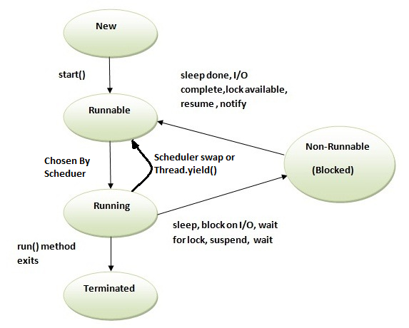
Thread Life Cycle

Slide 20
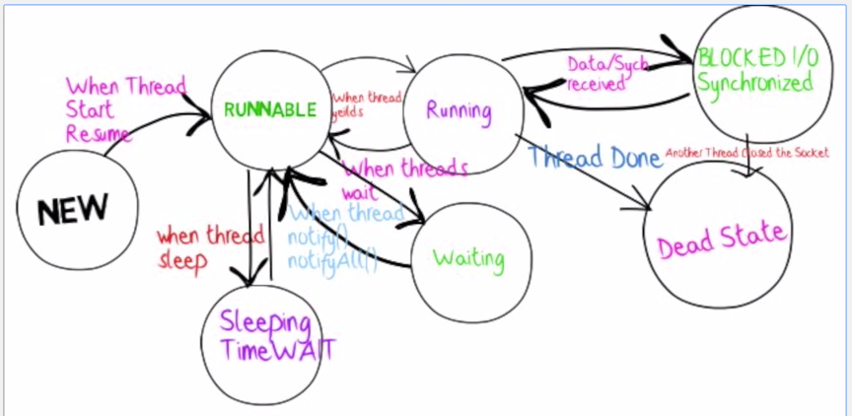
Thread Life Cycle – Another version

Slide 21
Some methods – influence scheduling
Some of the methods from the java.lang.Thread Class that can help us influence thread scheduling are as follows:
public static void sleep(long millis) throws InterruptedException
public static void yield()
Theoretically, to ‘yield’ means to let go, to give up, to surrender.
A yielding thread tells the virtual machine that it’s willing to let other threads be scheduled in its place.
This indicates that it’s not doing something too critical. Note that it’s only a hint, though, and not guaranteed to have any effect at all.
Moves from running state to runnable state
public final void join() throws InterruptedException
Allows one thread to wait for the completion of another.
If t is a Thread object whose thread is currently executing,
t.join();
causes the current thread to pause execution until t's thread terminates.
public final void setPriority(int newPriority)

Slide 22
Some methods
Few other methods
public static native Thread currentThread();
public final String getName()
public final synchronized void setName(String name)
public final native boolean isAlive();

Slide 23
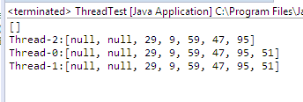
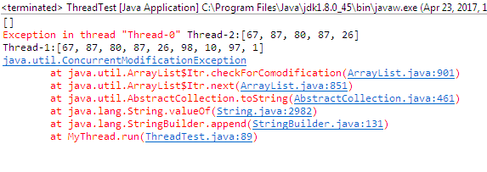
Example – without join()
public class ThreadTest{
public static void main(String[] args) {
MyThread t1 = new MyThread(3);
MyThread t2 = new MyThread(4);
MyThread t3 = new MyThread(2);
System.out.println(MyThread.list);
}
}
class MyThread extends Thread{
public static ArrayList<Integer> list = new ArrayList<Integer>();
public int num;
public MyThread(int n){
num = n;
start();
}
public void run(){
Random rand = new Random();
for(int i= 0; i<num; i++)
ist.add(rand.nextInt(100));
System.out.println(Thread.currentThread().getName()+":"+MyThread.list);
}
main() display empty list
3 threads display list with different items

Slide 24
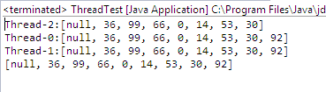
Example – join()
public class ThreadTest{
public static void main(String[] args) {
MyThread t1 = new MyThread(3);
MyThread t2 = new MyThread(4);
MyThread t3 = new MyThread(2);
try {
t1.join(); t2.join(); t3.join(); // main will wait until all three threads are complete
} catch (InterruptedException e) {
e.printStackTrace();
}
System.out.println(MyThread.list);
}
}
class MyThread extends Thread{
public static ArrayList<Integer> list = new ArrayList<Integer>();
public int num;
public MyThread(int n){
num = n;
start();
}
public void run(){
Random rand = new Random();
for(int i= 0; i<num; i++)
ist.add(rand.nextInt(100));
System.out.println(Thread.currentThread().getName()+":"+MyThread.list);
}
}
Output: main() prints the list after all threads are complete.
Issue: List is not populated with 10 items and has some null.

Slide 25
Synchronization

Slide 26
Synchronization
When two or more threads need access to a shared resource,
There needs some way to ensure that the resource will be used by only one thread at a time to avoid conflict.
e.g. one thread writing data while another thread is in the middle of reading it.
So, the resource should be locked by one thread so that no one can get access to the resource.
The process by which this is achieved is called synchronization.
One can synchronize your code in either of two ways. Both involve the use of the synchronized keyword,
Method level
class Callme {
synchronized void call(String msg) {
...
Object level
synchronized(objRef) {
// statements to be synchronized
}
Mainly when the class is not designed by you and you do not have access to source code.
Class is not designed to handle multi threading(no synchronized keyword),
Don’t want to synchronized at method level.

Slide 27
Synchronization
For both cases the lock is acquired at object level not method.
Every Java object has a Iock. And a lock has only one 'key. .
Most of the time, the Iock is at unlocked and nobody cares.
If an object has synchronized methods, a thread can enter one of the synchronized methods ONLY if the "key for the object's Iock is available.
In other words, only if another thread hasn't already grabbed the one "key.

Slide 28


Example – without synchronization
public class ThreadTest{
public static void main(String[] args) {
MyThread t1 = new MyThread(3);
MyThread t2 = new MyThread(4);
MyThread t3 = new MyThread(2);
try {
t1.join(); t2.join(); t3.join(); // wait until all three thread are complete
} catch (InterruptedException e) {
e.printStackTrace();
}
System.out.println(MyThread.list);
}
}
class MyThread extends Thread{
public static ArrayList<Integer> list = new ArrayList<Integer>();
public int num;
public MyThread(int n){
num = n;
start();
}
public void run(){
Random rand = new Random();
for(int i= 0; i<num; i++)
ist.add(rand.nextInt(100));
}
}
Sample Output:
ArrayList will not be always correctly populated
null values can be added.
Less than 9 values can be added.
In this run only 8 values are added instead of 9.

Slide 29

Example – with synchronization
public class ThreadTest{
public static void main(String[] args) {
MyThread t1 = new MyThread(3);
MyThread t2 = new MyThread(4);
MyThread t3 = new MyThread(2);
try {
t1.join(); t2.join(); t3.join(); // wait until all three thread are complete
} catch (InterruptedException e) {
e.printStackTrace();
}
System.out.println(MyThread.list);
}
}
class MyThread extends Thread{
public static ArrayList<Integer> list = new ArrayList<Integer>();
public int num;
public MyThread(int n){
num = n;
start();
}
public void run(){
Random rand = new Random();
for(int i= 0; i<num; i++)
synchronized (list) {
list.add(rand.nextInt(100));
}
}
}
Output:
List is correctly populated with 9 values

Slide 30
Synchronization – Any disadvantages?
Synchronization doesn't come for free.
First, a synchronized method has a certain amount of overhead.
When code hits a synchronized method, there's going to be a performance hit while the matter of “Is the key available“ is resolved.
Second, a synchronized method can slow your program down because synchronization restricts concurrency.
a synchronized method forces other threads to get in line and wait their turn.
Third, and most frightening, synchronized methods can lead to deadlock.
Thread deadlock happens when you have two threads, both of which are holding a key the other thread wants. There's no way out of this scenario, so the two threads will simply sit and wait. And wait. And wait.

Slide 31
Synchronization – How to overcome?
A good rule of thumb Is to synchronize only the bare minimum that should be synchronized.
And In fact, you can synchronize at a granularity that's even smaller than a method.
you can use the synchronized keyword to synchronize at the more fine-grained level of one or more statements, rather than at the whole-method level.

Slide 32
Inter-thread Communication
To avoid polling, Java includes an elegant inter-process communication mechanism via the wait( ), notify( ), and notifyAll( ) methods.
These methods are implemented as final methods in Object,
so all classes have them.
All three methods can be called only from within a synchronized context.
wait( )
when wait() method is invoked on an object,
the thread executing that code gives up its lock on the object immediately
and moves the thread to the wait/blocked state.
throws InterruptedException
notify():
This wakes up threads that called wait() on the same object and
moves the thread to ready/runnable state.
notifyAll():
This wakes up all the threads that called wait() on the same object.
One of the threads will be granted access.

Slide 33
Producer-Consumer Problem
In computing, the producer–consumer problem (also known as the bounded-buffer problem) is a classic example of a multi-process synchronization problem.
The problem describes two processes, the producer and the consumer, who share a common, fixed-size buffer used as a queue.
Producer
puts items into the buffer
must wait until the buffer has space before it can put something in
Consumers
takes items out of the buffer
must wait until something is in the buffer before it can take something out.
A condition variable represents a queue of threads waiting for some condition to be signaled.

Slide 34
Producer-Consumer Problem
Common Resource - MyStack
import java.util.ArrayList;
public class MyStack {
private ArrayList<Integer> data = new ArrayList<Integer>();
public synchronized void push(int num){
// add the num to the ArrayList (data)
data.add(num);
System.out.println("Pushed:" + num + ":"+ data);
notify(); // wakes up threads that called wait() during pop
}
public synchronized int pop() {
if (data.size() == 0){ // if no data available the Thread has to wait
try {
wait();
} catch (InterruptedException e) {
System.out.println(e.getMessage());
}
}
// return the last item and remove that item from the list
int item = data.remove(data.size() - 1);
System.out.println("Poped:" + item);
return item;
}
}
}

Slide 35
Producer-Consumer Problem
Producer
import java.util.Random;
public class Producer implements Runnable{
MyStack myStack;
public Producer(MyStack s) {
myStack = s;
}
public void run() {
int num;
Random rand = new Random();
for (int i=0; i<50; i++){
// generate a random number between 0 to 10 and call the push method using myStack.
System.out.println(Thread.currentThread().getName());
num = rand.nextInt(10);
myStack.push(num);
// Call the sleep method and pass ~ 100 ms.
try {
Thread.sleep(100);}
catch (InterruptedException e) {
e.printStackTrace();
}
}
}
}

Slide 36
Producer-Consumer Problem
Consumer
public class Consumer implements Runnable{
MyStack myStack;
public Consumer(MyStack s) {
myStack = s;
}
public void run() {
int num;
for (int i=0; i<50; i++){
System.out.println(Thread.currentThread().getName());
// Call the pop method and print the number. Also sleep for ~ 100 ms.
try {
num = myStack.pop();
} catch (Exception e1) {
System.out.println(e1.getMessage());;
}
try {
Thread.sleep(100);
} catch (InterruptedException e) {
e.printStackTrace();
}
}
}
}

Slide 37
Producer-Consumer Problem
Application Class
public class MainClass {
public static void main(String[] args) {
MyStack st = new MyStack();
// Start 2 Threads; 1 for Producer and 1 for Consumer.
// For both Producer and Consumer pass the same st object as parameter
new Thread(new Producer(st), "Producer").start();
new Thread(new Consumer(st), "Consumer ").start();
}
}

Slide 38
Reference
Java: Complete Reference - Chapter 11

